Slide 1


Azərbaycan Dövlət Neft və Sənaye Universiteti
Calculus
Single Variable

Slide 2
Integration:
Area Problem

Slide 3
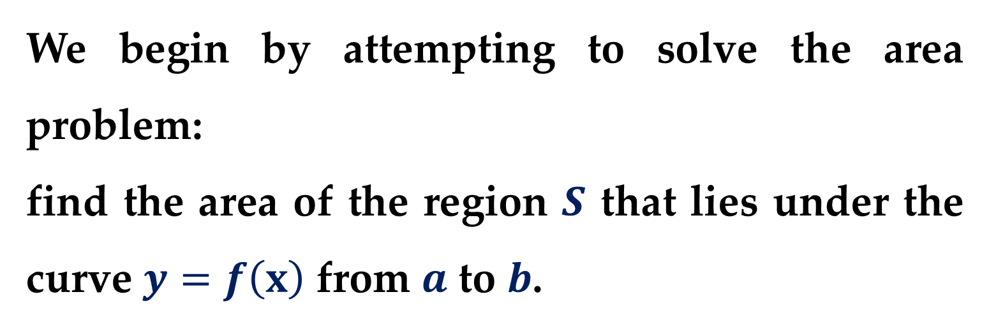
In this lecture we will discover that in trying to find the area under a curve or the distance traveled by an object, we end up with the same special type of limit.
We begin by attempting to solve the area problem:
find the area of the region $S$ that lies under the curve $y=f\left(x\right)$ from $a$ to $b$.

Slide 4
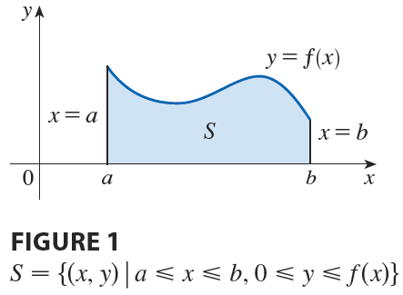
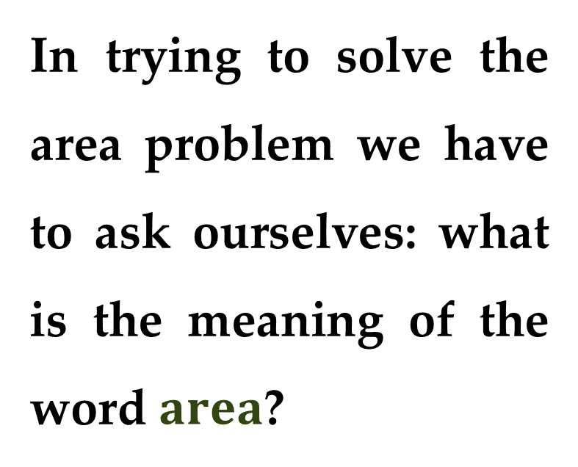
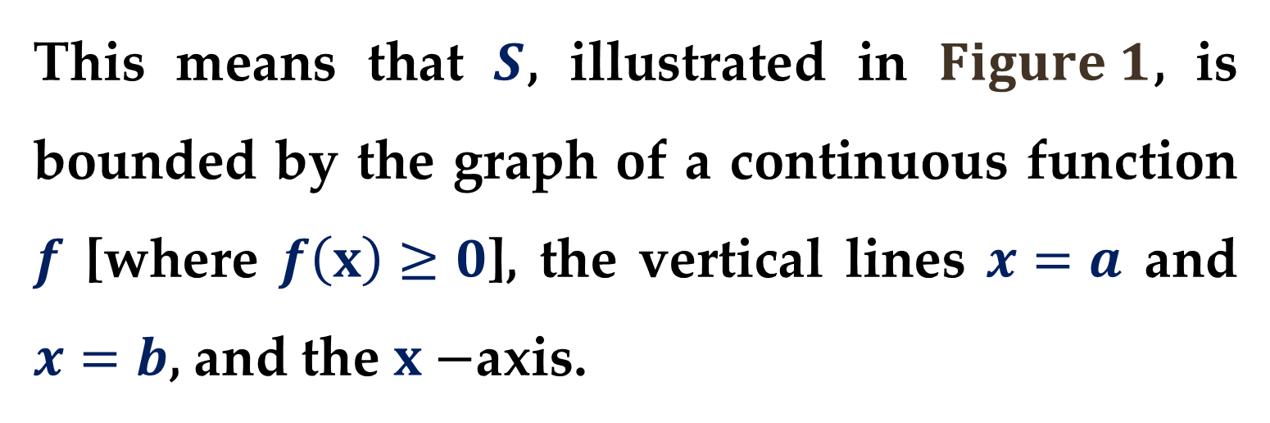
This means that $S$, illustrated in $Figure 1$, is bounded by the graph of a continuous function $f$ [where $f\left(x\right)≥0$], the vertical lines $x=a$ and $x=b$, and the $x−$axis.
In trying to solve the area problem we have to ask ourselves: what is the meaning of the word $area$?

Slide 5
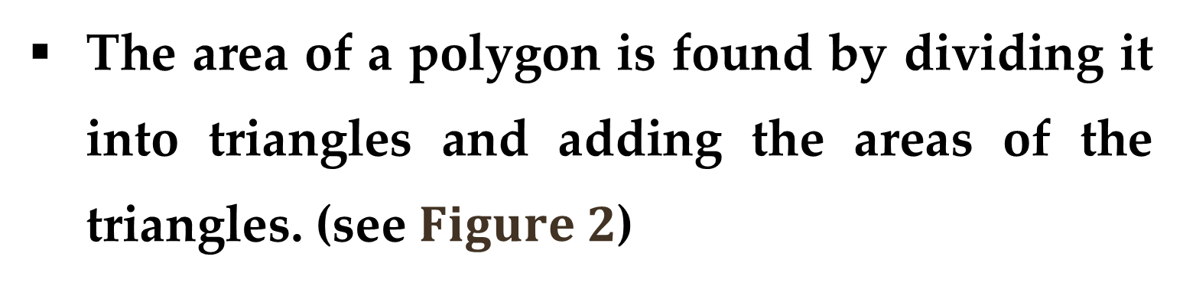
This question is easy to answer for regions with straight sides.
For a rectangle, the area is defined as the product of the length and the width.
The area of a triangle is half the base times the height.
The area of a polygon is found by dividing it into triangles and adding the areas of the triangles. (see $Figure 2$)

Slide 6
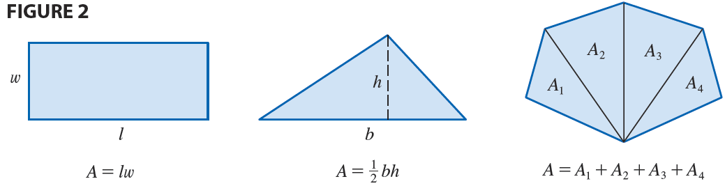
It is not so easy, however, to find the area of a region with curved sides.
We all have an intuitive idea of what the area of a region is.

Slide 7

But part of the area problem is to make this intuitive idea precise by giving an exact definition of area.
Recall that the origins of calculus are connected to two classic problems:
the tangent line problem
the area problem.
Let$’$s now investigate the area problem.

Slide 8
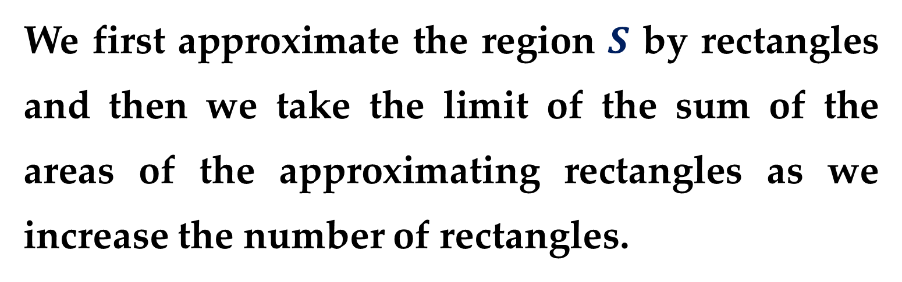
Recall that in defining a tangent to a curve we first approximated the slope of the tangent line by slopes of secant lines and then we took the limit of these approximations.
We will pursue a similar idea for areas.
We first approximate the region $S$ by rectangles and then we take the limit of the sum of the areas of the approximating rectangles as we increase the number of rectangles.

Slide 9
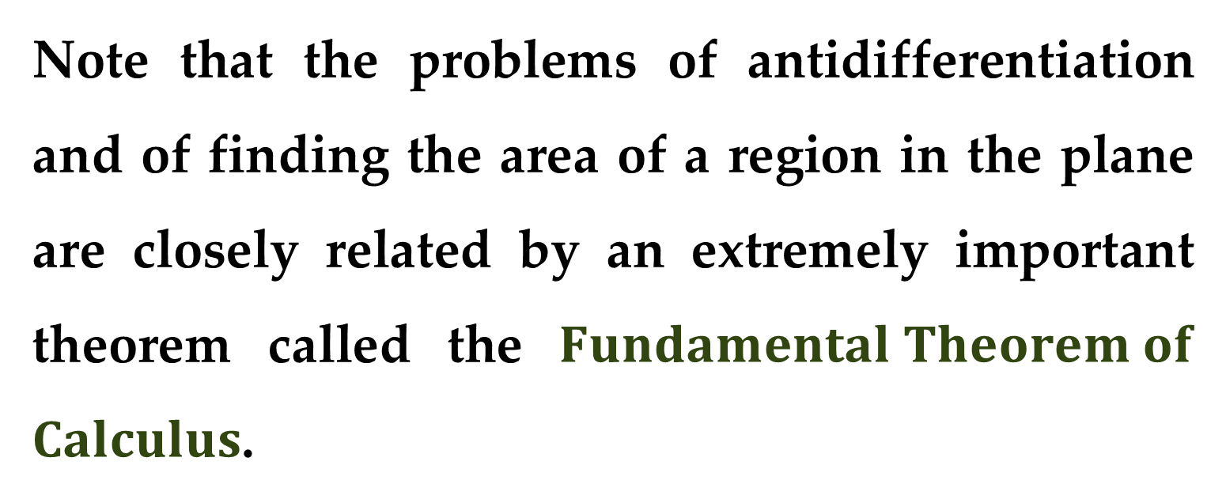
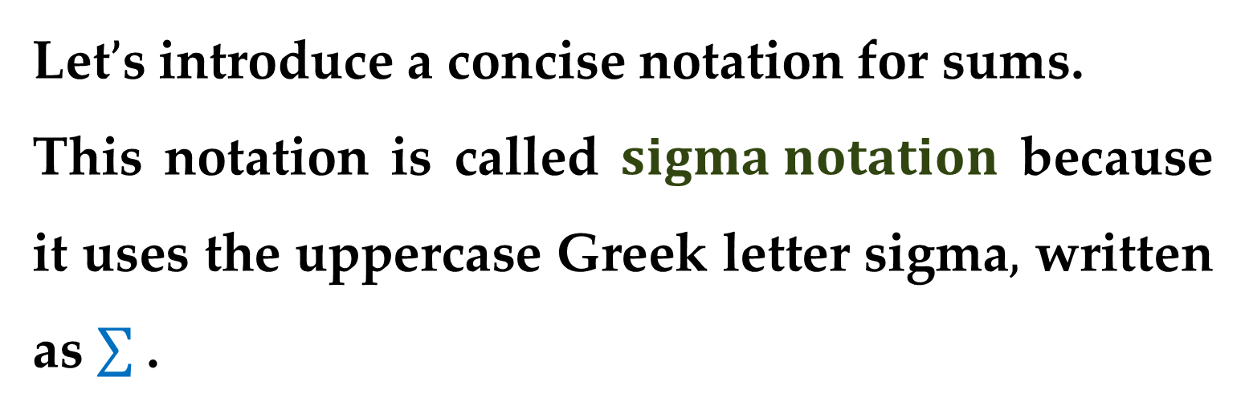
Note that the problems of antidifferentiation and of finding the area of a region in the plane are closely related by an extremely important theorem called the $Fundamental Theorem of$ $Calculus$.
Let$’$s introduce a concise notation for sums.
This notation is called $sigma notation$ because it uses the uppercase Greek letter sigma$,$ written as .

Slide 10
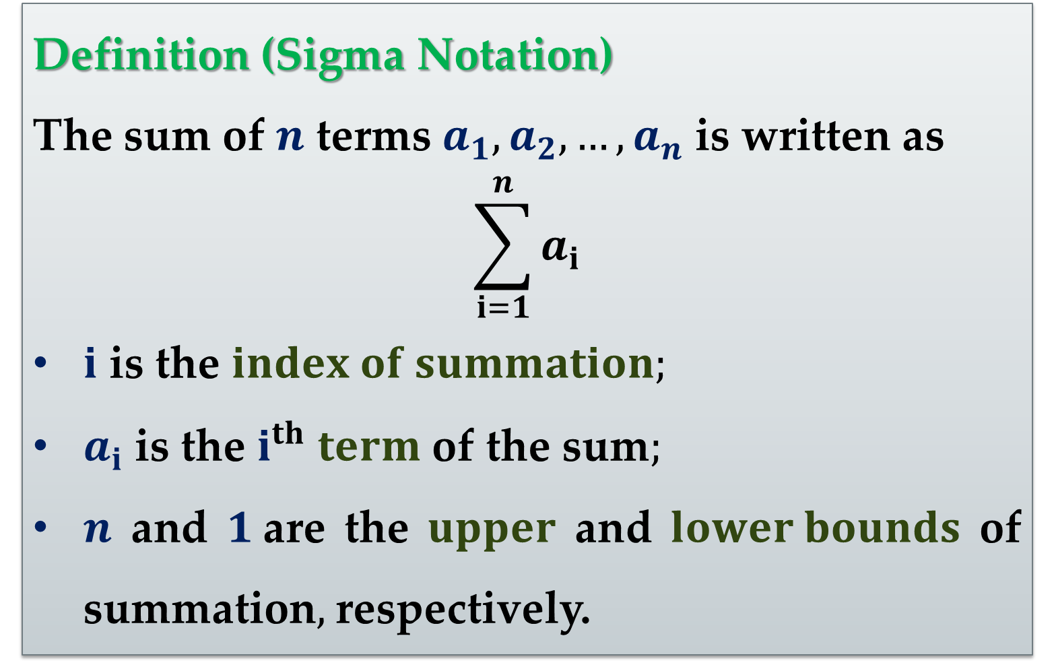
Definition (Sigma Notation)
The sum of $n$ terms $a_{1},a_{2},…,a_{n}$ is written as
$$\sum_{i=1}^{n}{a_{i}}$$
$i$ is the $index of summation;$
$a_{i}$ is the $i^{th}$ $term$ of the sum$;$
$n$ and $1$are the $upper$ and $lower bounds$ of summation$,$ respectively.

Slide 11
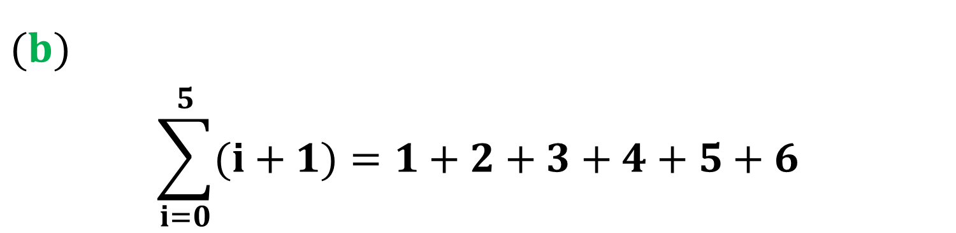
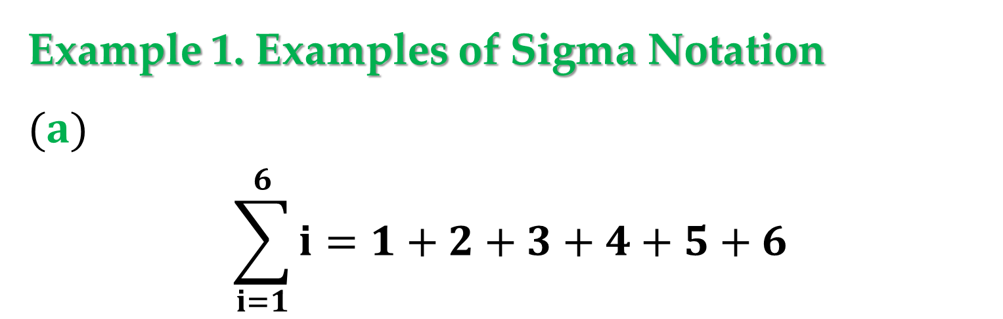
Example 1. Examples of Sigma Notation
$(a)$
$$\sum_{i=1}^{6}{i}=1+2+3+4+5+6$$
$(b)$
$$\sum_{i=0}^{5}{(i+1)}=1+2+3+4+5+6$$

Slide 12
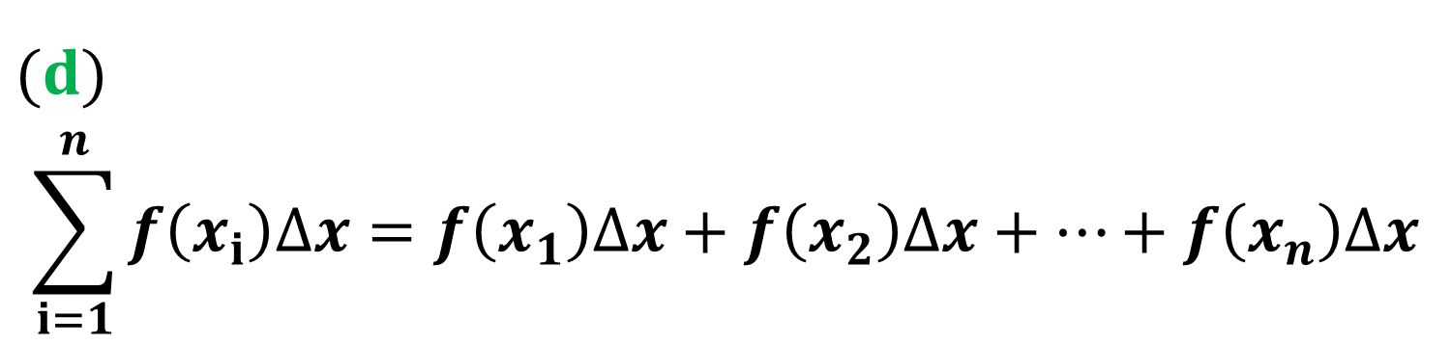
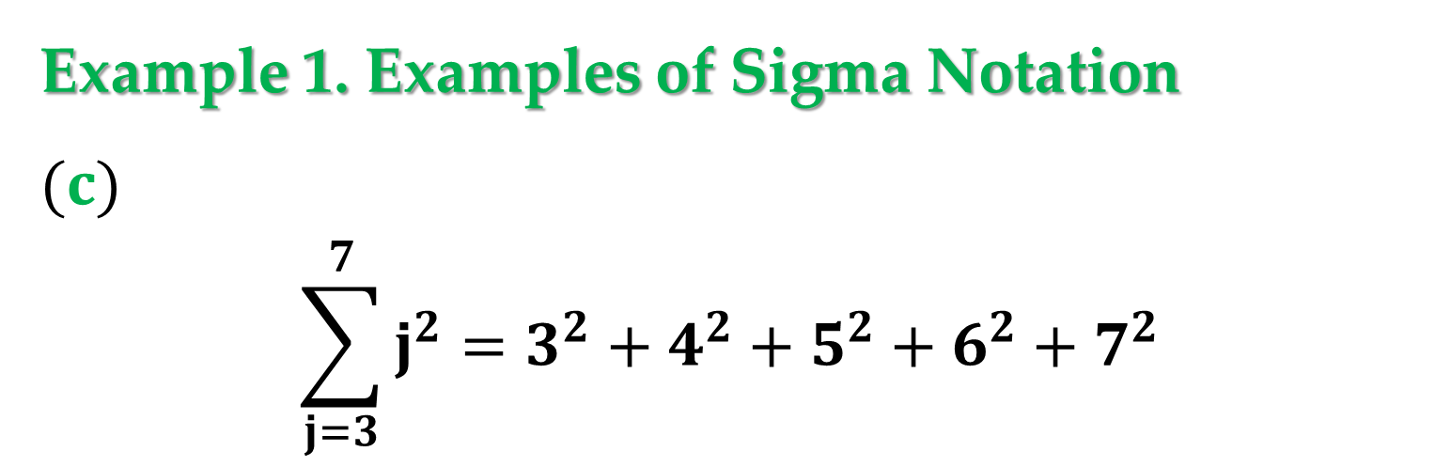
Example 1. Examples of Sigma Notation
$(c)$
$$\sum_{j=3}^{7}{j^{2}}=3^{2}+4^{2}+5^{2}+6^{2}+7^{2}$$
$(d)$
$$\sum_{i=1}^{n}{f\left(x_{i}\right)∆x}=f\left(x_{1}\right)∆x+f\left(x_{2}\right)∆x+…+f\left(x_{n}\right)∆x$$

Slide 13
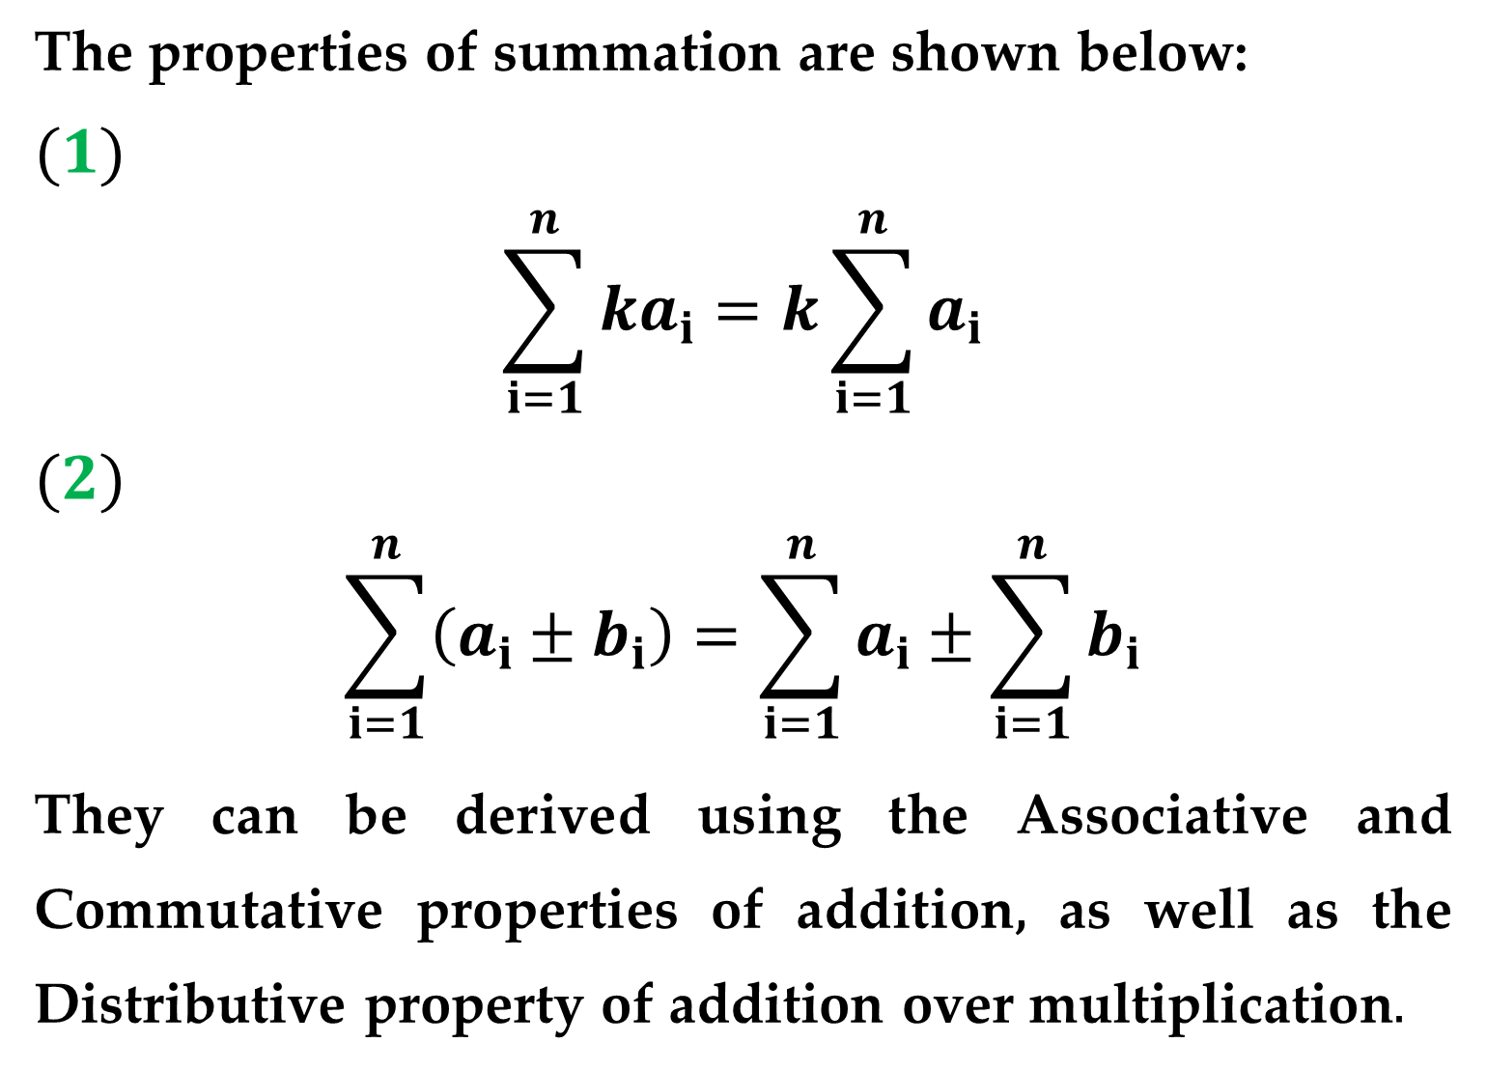
The properties of summation are shown below:
$(1)$
$$\sum_{i=1}^{n}{ka_{i}}=k\sum_{i=1}^{n}{a_{i}}$$
$(2)$
$$\sum_{i=1}^{n}{\left(a_{i}±b_{i}\right)}=\sum_{i=1}^{n}{a_{i}}±\sum_{i=1}^{n}{b_{i}}$$
They can be derived using the Associative and Commutative properties of addition, as well as the Distributive property of addition over multiplication$.$

Slide 14
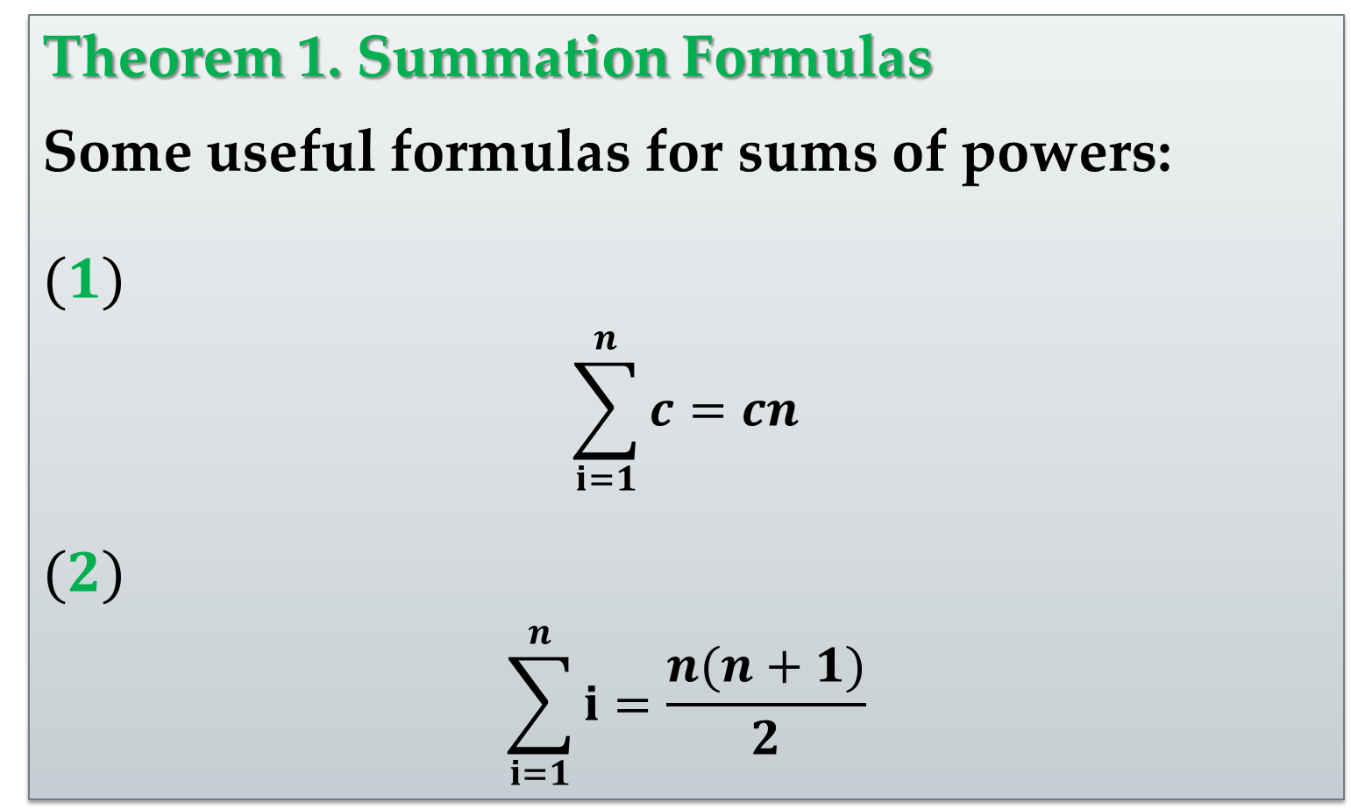
Theorem 1. Summation Formulas
Some useful formulas for sums of powers:
$(1)$
$$\sum_{i=1}^{n}{c}=cn$$
$(2)$
$$\sum_{i=1}^{n}{i}=\frac{n(n+1)}{2}$$

Slide 15
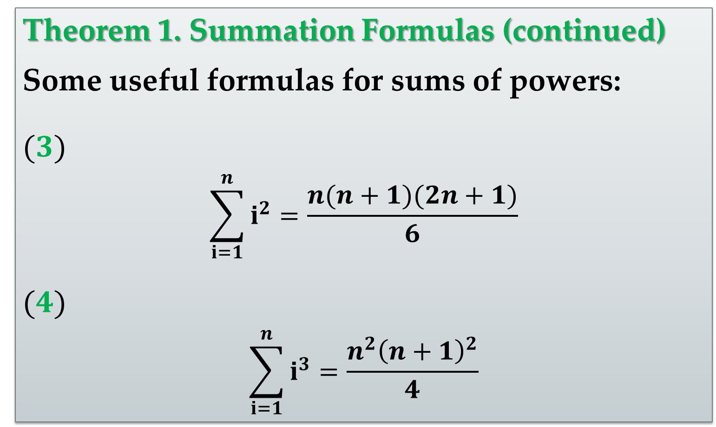
Theorem 1. Summation Formulas (continued)
Some useful formulas for sums of powers:
$(3)$
$$\sum_{i=1}^{n}{i^{2}}=\frac{n(n+1)(2n+1)}{6}$$
$(4)$
$$\sum_{i=1}^{n}{i^{3}}=\frac{n^{2}{\left(n+1\right)}^{2}}{4}$$

Slide 16
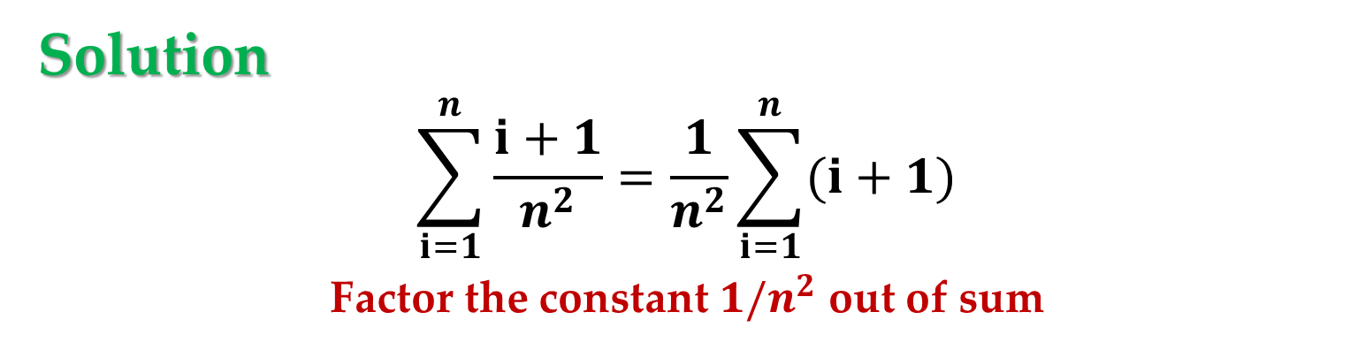
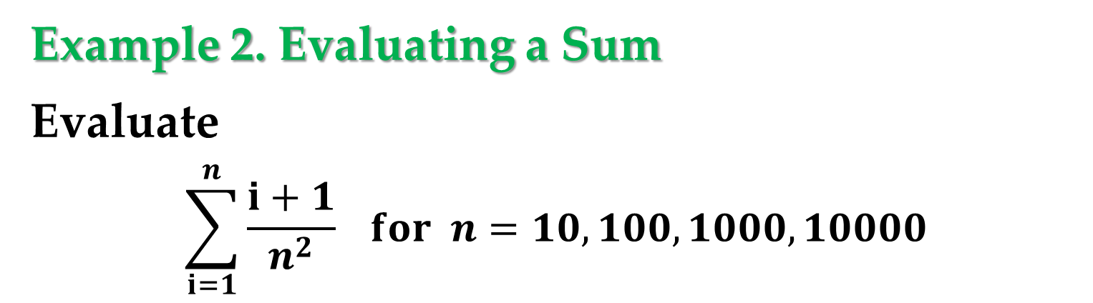

Example 2. Evaluating a Sum
Evaluate
$$\sum_{i=1}^{n}{\frac{i+1}{n^{2}}} for n=10, 100, 1000, 10000$$
Solution
$$\sum_{i=1}^{n}{\frac{i+1}{n^{2}}}=\frac{1}{n^{2}}\sum_{i=1}^{n}{(i+1)}$$
Factor the constant $1/n^{2}$ out of sum
$$=\frac{1}{n^{2}}\left(\sum_{i=1}^{n}{i}+\sum_{i=1}^{n}{1}\right)$$
Write as two sums

Slide 17

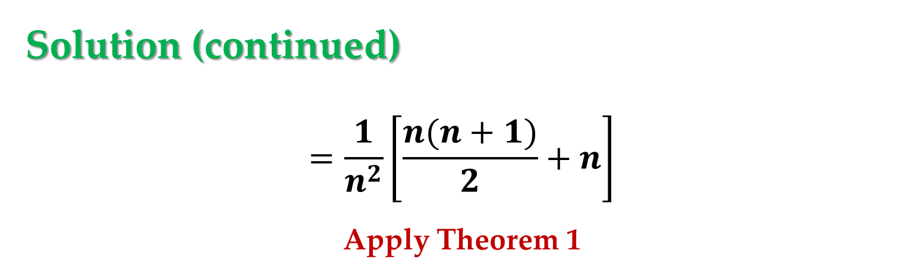
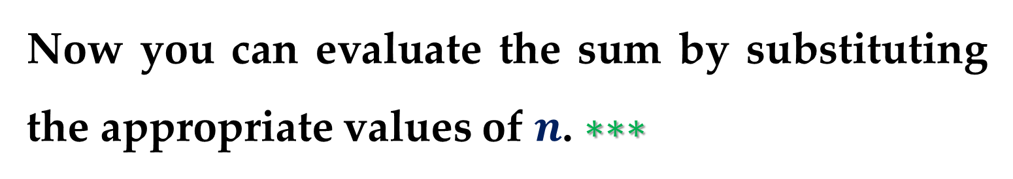
Solution (continued)
$$=\frac{1}{n^{2}}\left[\frac{n(n+1)}{2}+n\right]$$
Apply Theorem 1
$$=\frac{1}{n^{2}}\left[\frac{n^{2}+3n}{2}\right]=\frac{n+3}{2n}$$
Simplify
Now you can evaluate the sum by substituting the appropriate values of $n$. $∗∗∗$

Slide 18
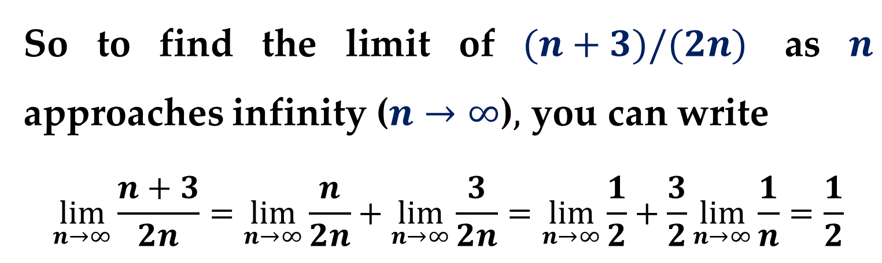
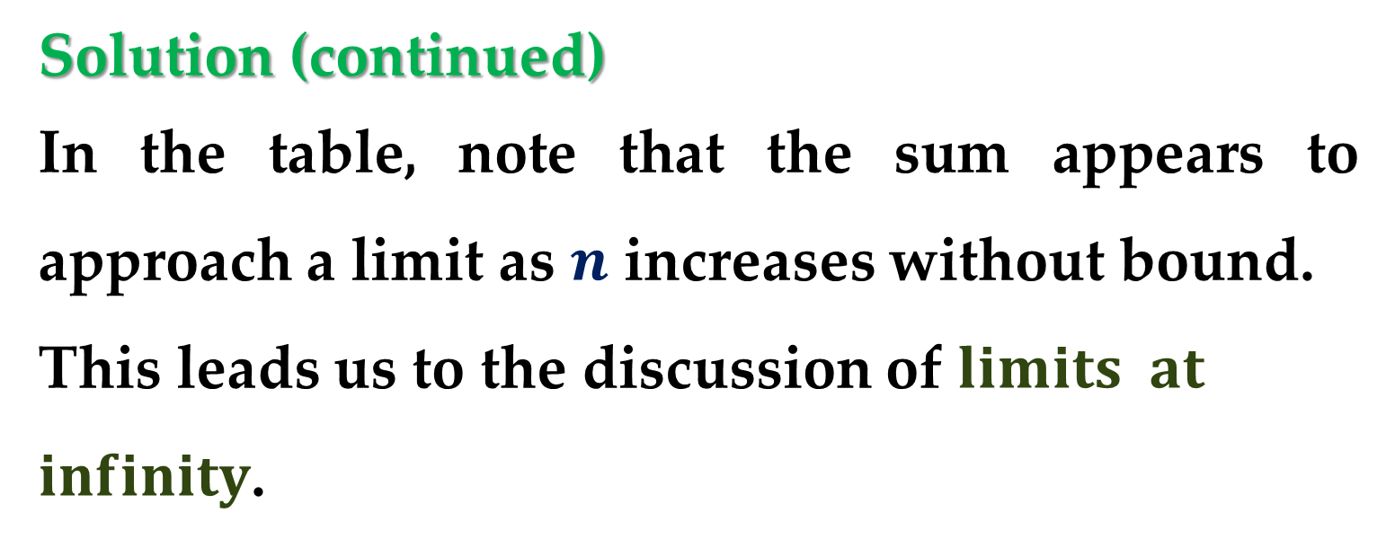
Solution (continued)
In the table, note that the sum appears to approach a limit as $n$ increases without bound.
This leads us to the discussion of $limits at$
$infinity$.
So to find the limit of $(n+3)/(2n)$ as $n$ approaches infinity ($n→∞$)$,$ you can write
$$\lim_{n→∞}{\frac{n+3}{2n}}=\lim_{n→∞}{\frac{n}{2n}}+\lim_{n→∞}{\frac{3}{2n}}=\lim_{n→∞}{\frac{1}{2}}+\frac{3}{2}\lim_{n→∞}{\frac{1}{n}}=\frac{1}{2}$$

Slide 19
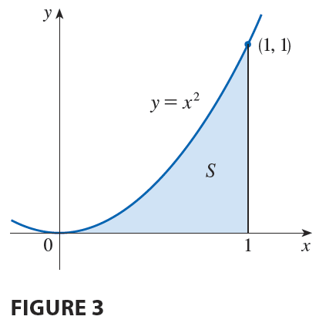
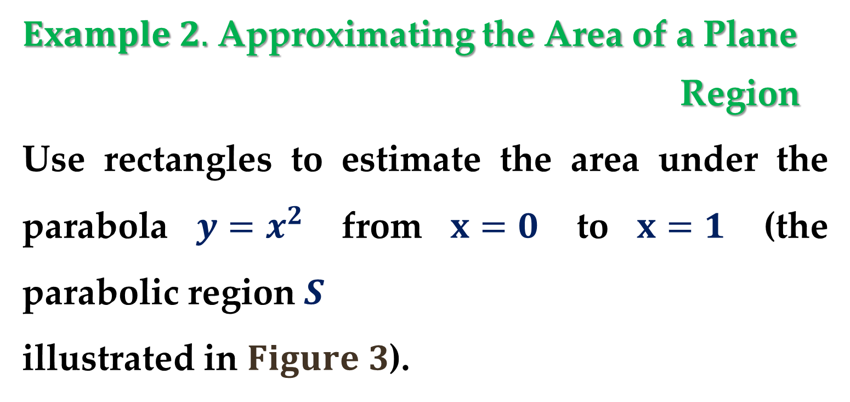
$Example 2.$ Approximating the Area of a Plane
Region
Use rectangles to estimate the area under the parabola $y=x^{2}$ from $x=0$ to $x=1$ (the parabolic region $S$
illustrated in $Figure 3$).

Slide 20
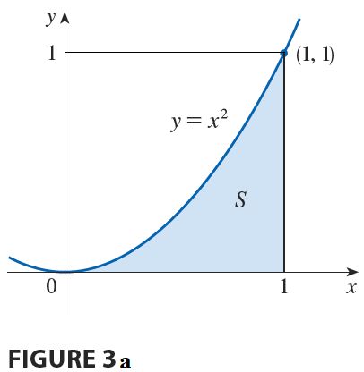
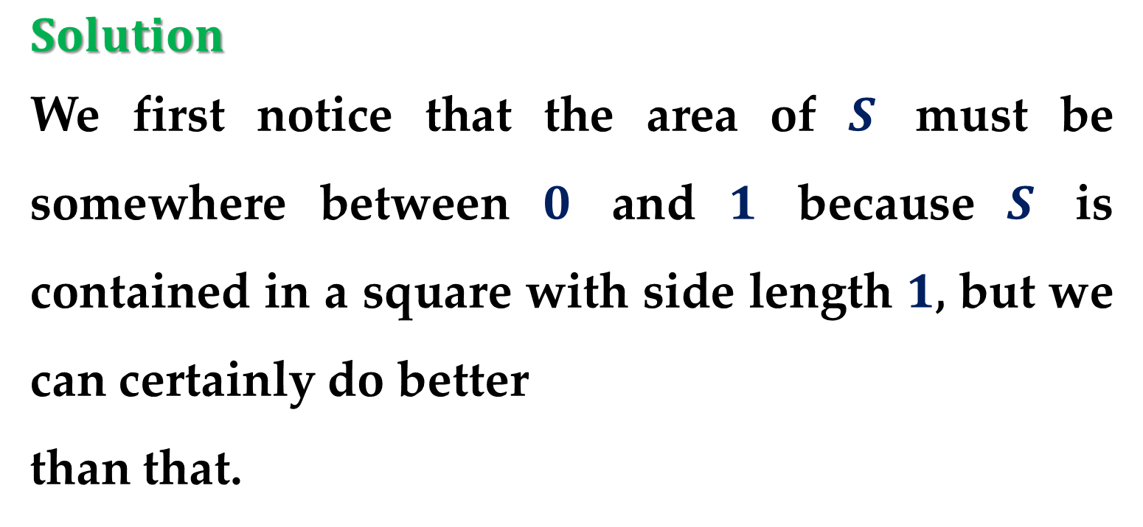
$$Solution$$
We first notice that the area of $S$ must be somewhere between $0$ and $1$ because $S$ is contained in a square with side length $1$, but we can certainly do better
than that.

Slide 21
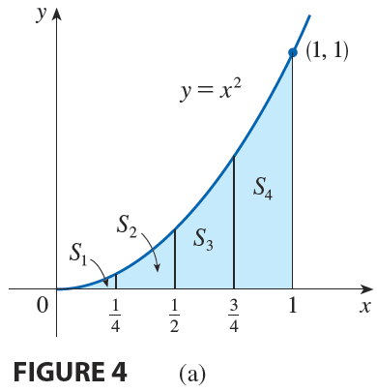
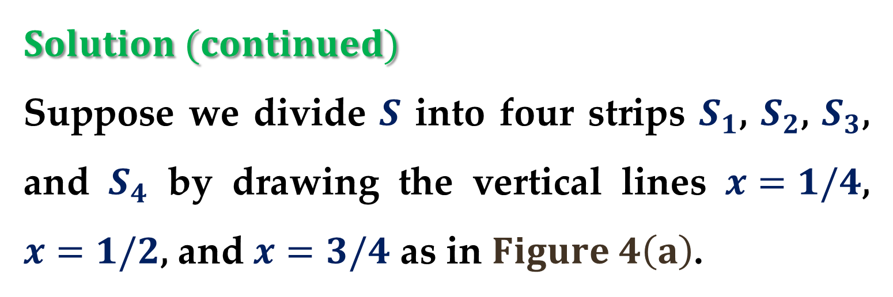
$$Solution (continued)$$
Suppose we divide $S$ into four strips $S_{1}$, $S_{2}$, $S_{3}$, and $S_{4}$ by drawing the vertical lines $x=1/4$, $x=1/2$, and $x=3/4$ as in $Figure 4\left(a\right)$.

Slide 22
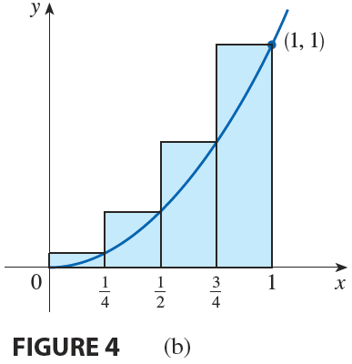
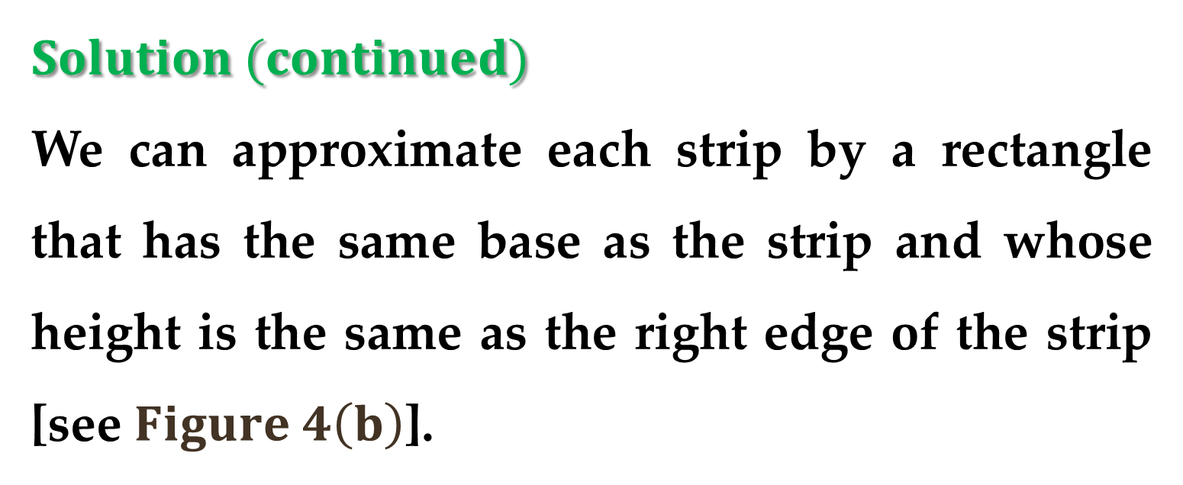
$$Solution (continued)$$
We can approximate each strip by a rectangle that has the same base as the strip and whose height is the same as the right edge of the strip [see $Figure 4\left(b\right)$].

Slide 23
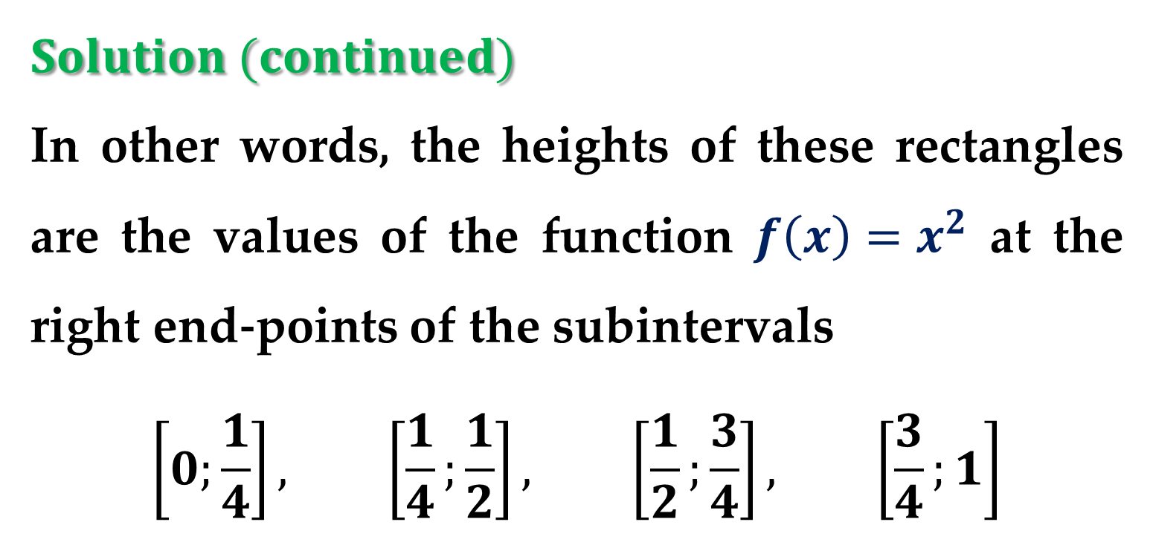
$$Solution (continued)$$
In other words, the heights of these rectangles are the values of the function $f\left(x\right)=x^{2}$ at the right end-points of the subintervals
$$\left[0;\frac{1}{4}\right], \left[\frac{1}{4};\frac{1}{2}\right], \left[\frac{1}{2};\frac{3}{4}\right], \left[\frac{3}{4};1\right]$$
evaluate $f$ at the right endpoints of these intervals

Slide 24
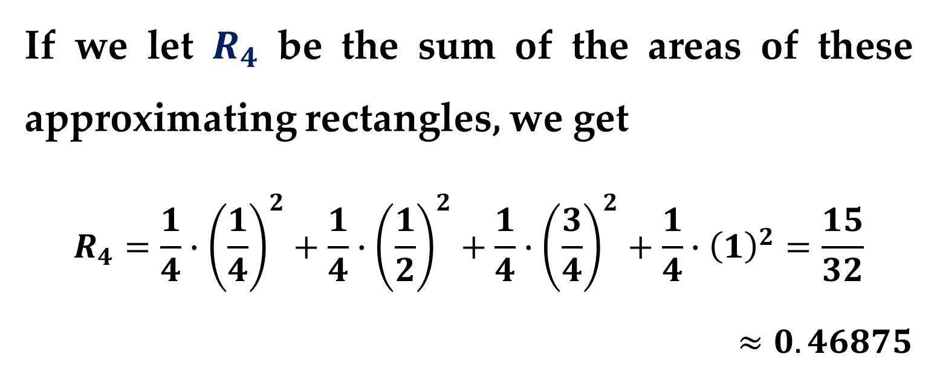
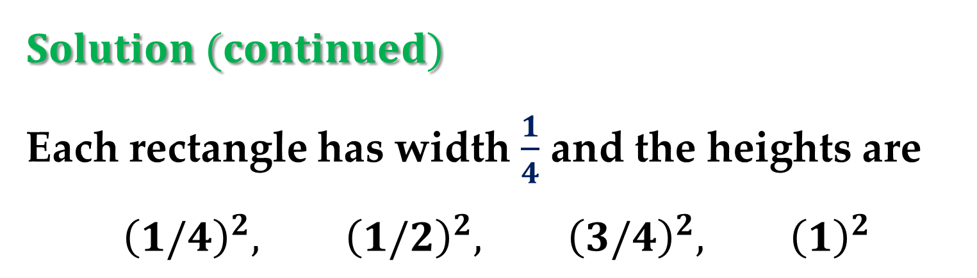
$$Solution (continued)$$
Each rectangle has width $\frac{1}{4}$ and the heights are
$${\left(1/4\right)}^{2}, {\left(1/2\right)}^{2}, {\left(3/4\right)}^{2}, {\left(1\right)}^{2}$$
If we let $R_{4}$ be the sum of the areas of these approximating rectangles, we get
$$R_{4}=\frac{1}{4}∙{\left(\frac{1}{4}\right)}^{2}+\frac{1}{4}∙{\left(\frac{1}{2}\right)}^{2}+\frac{1}{4}∙{\left(\frac{3}{4}\right)}^{2}+\frac{1}{4}∙{\left(1\right)}^{2}=\frac{15}{32}$$
$$≈0.46875$$

Slide 25
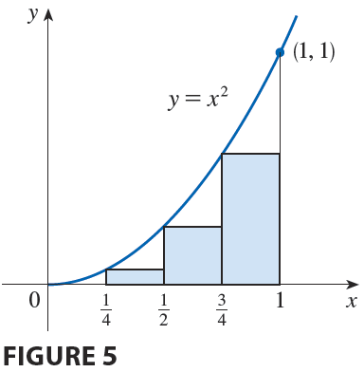
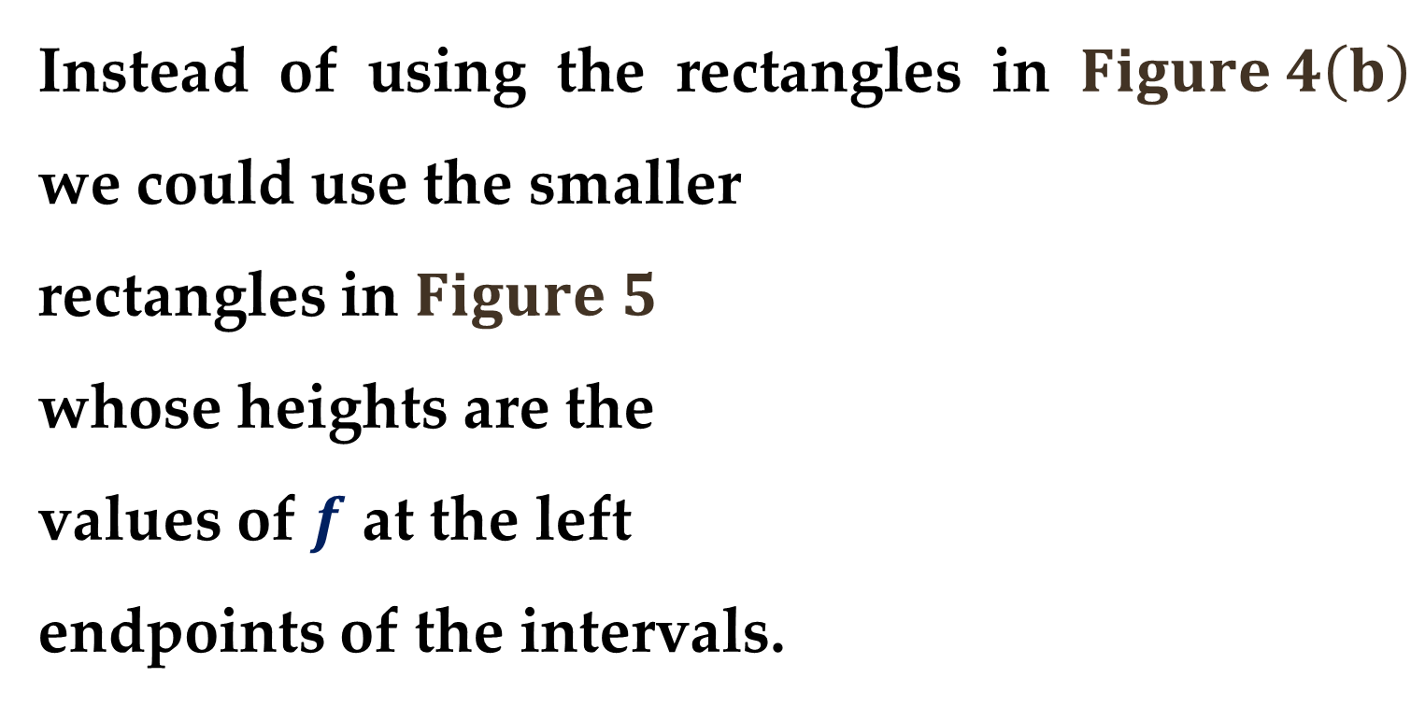
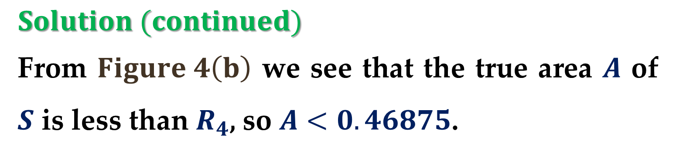
$$Solution (continued)$$
From $Figure 4\left(b\right)$ we see that the true area $A$ of $S$ is less than $R_{4}$, so $A<0.46875$.
Instead of using the rectangles in $Figure 4\left(b\right)$ we could use the smaller
rectangles in $Figure 5$
whose heights are the
values of $f$ at the left
endpoints of the intervals.

Slide 26
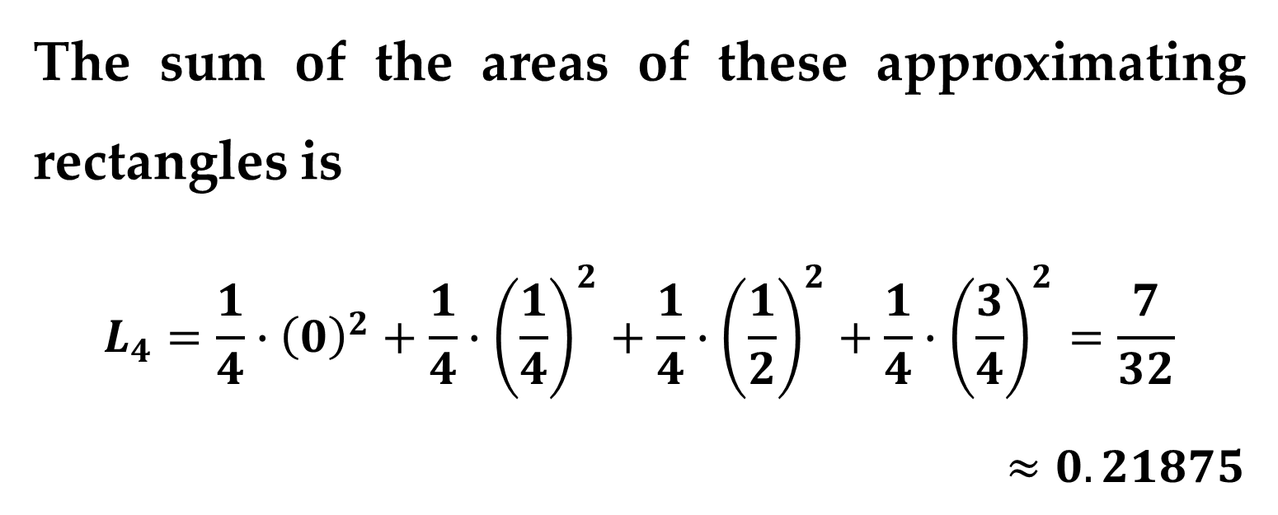
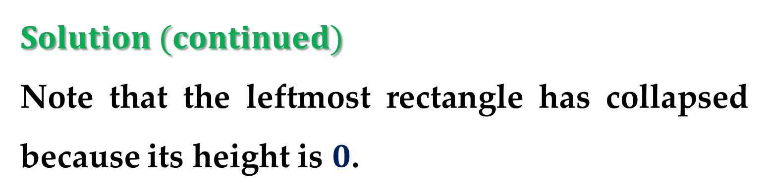
$$Solution (continued)$$
Note that the leftmost rectangle has collapsed because its height is $0$.
The sum of the areas of these approximating rectangles is
$$L_{4}=\frac{1}{4}∙{\left(0\right)}^{2}+\frac{1}{4}∙{\left(\frac{1}{4}\right)}^{2}+\frac{1}{4}∙{\left(\frac{1}{2}\right)}^{2}+\frac{1}{4}∙{\left(\frac{3}{4}\right)}^{2}=\frac{7}{32}$$
$$≈0.21875$$

Slide 27
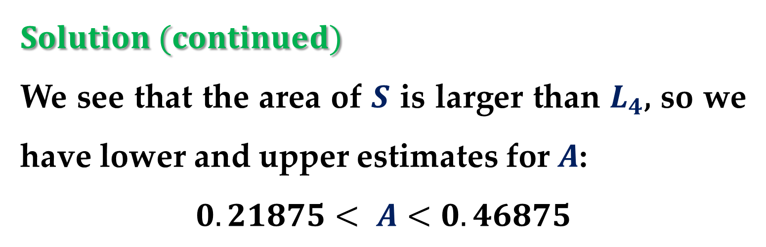
$$Solution (continued)$$
We see that the area of $S$ is larger than $L_{4}$, so we have lower and upper estimates for $A$:
$$0.21875< A<0.46875$$
We can repeat this procedure with a larger number of strips.

Slide 28
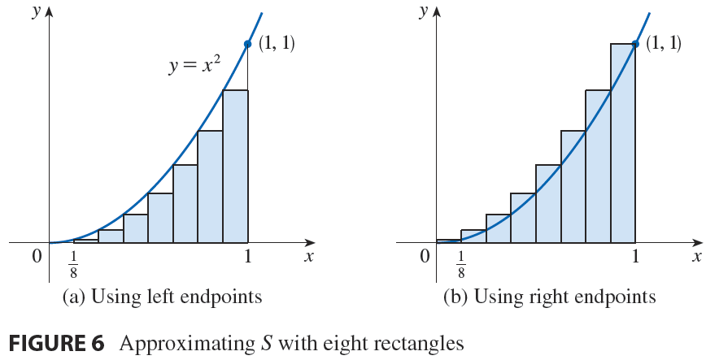
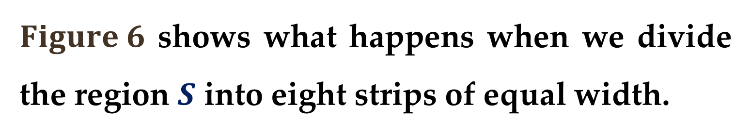
$$Solution (continued)$$
$Figure 6$ shows what happens when we divide the region $S$ into eight strips of equal width.

Slide 29
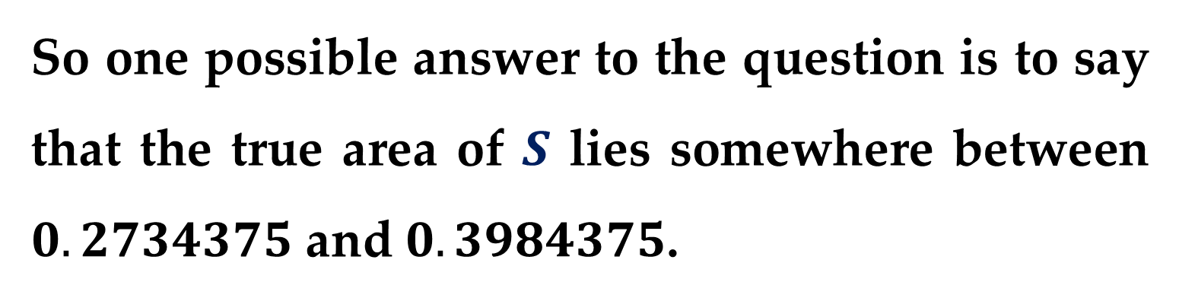
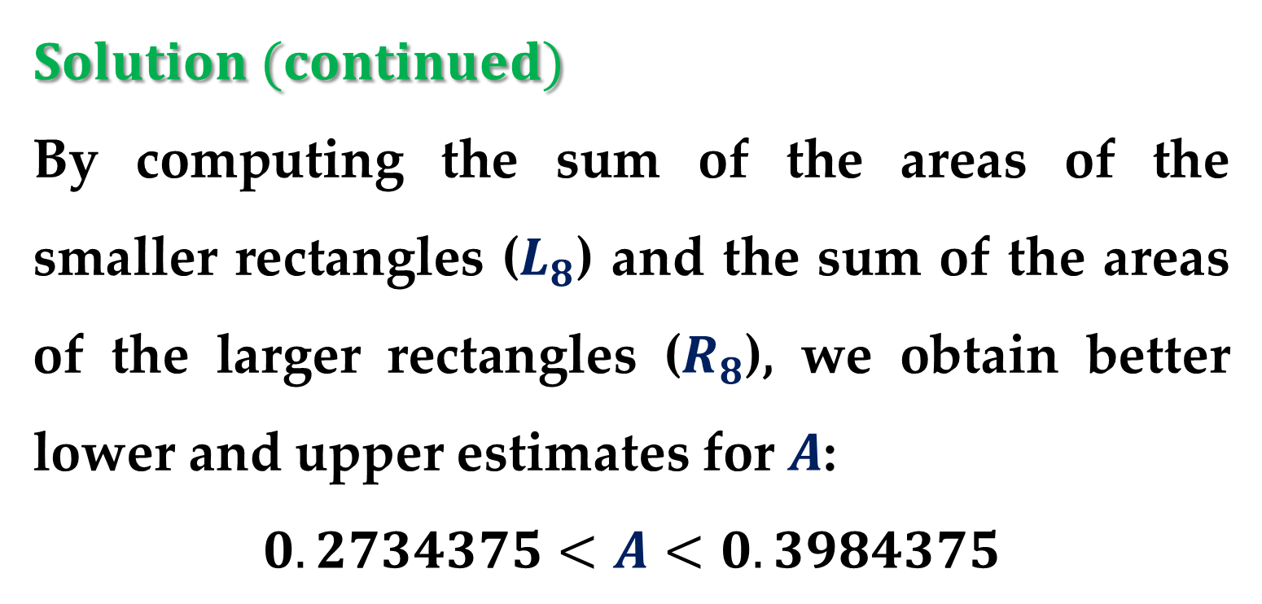
$$Solution (continued)$$
By computing the sum of the areas of the smaller rectangles ($L_{8}$) and the sum of the areas of the larger rectangles ($R_{8}$), we obtain better lower and upper estimates for $A$:
$$0.2734375<A<0.3984375$$
So one possible answer to the question is to say that the true area of $S$ lies somewhere between $0.2734375$ and $0.3984375$.

Slide 30
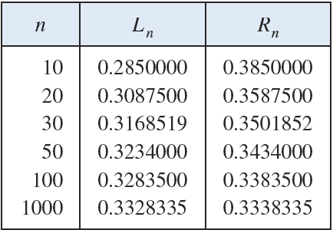
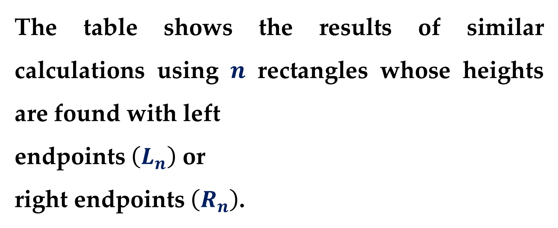
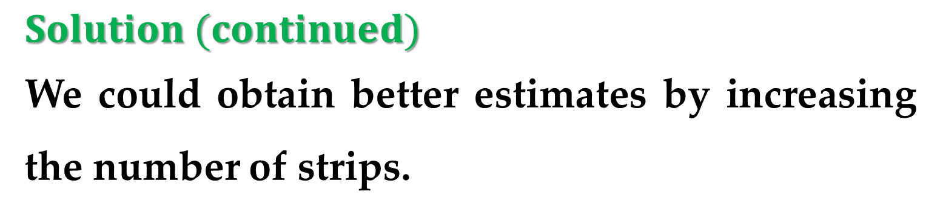
$$Solution (continued)$$
We could obtain better estimates by increasing the number of strips.
The table shows the results of similar calculations using $n$ rectangles whose heights are found with left
endpoints $\left(L_{n}\right)$ or
right endpoints $\left(R_{n}\right)$.

Slide 31
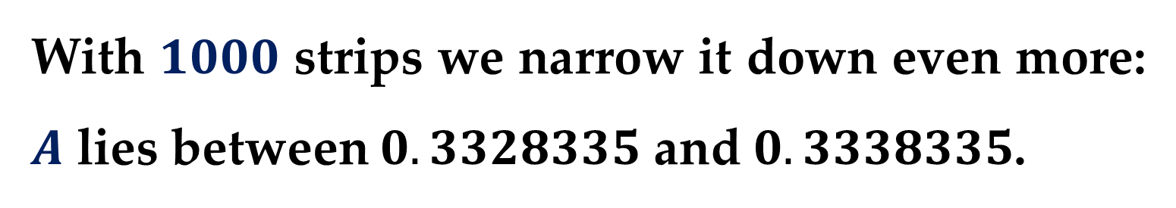
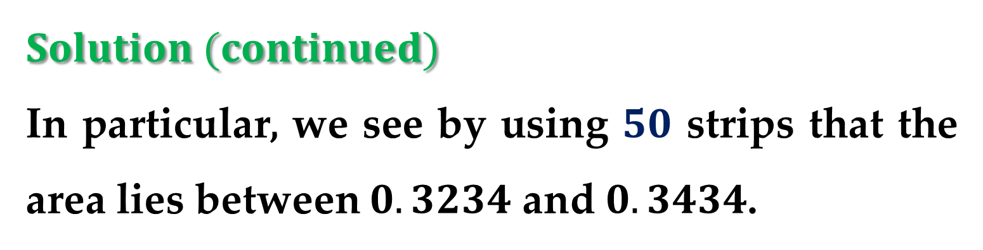
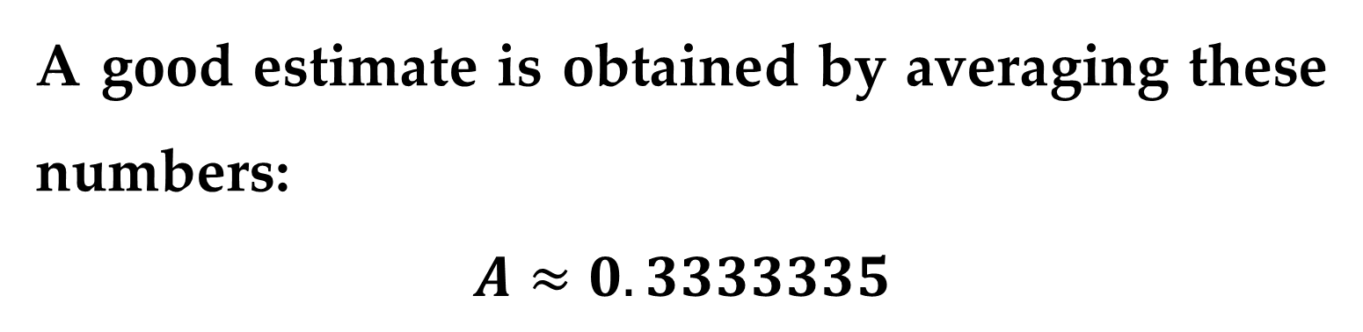
$$Solution (continued)$$
In particular, we see by using $50$ strips that the area lies between $0.3234$ and $0.3434$.
With $1000$ strips we narrow it down even more: $A$ lies between $0.3328335$ and $0.3338335$.
A good estimate is obtained by averaging these numbers:
$$A≈0.3333335$$

Slide 32


From the values listed in the table in $Example 2$, it looks as if $R_{n}$ is approaching $1/3$ as $n$ increases without bound.
We confirm this in the next example.
$Example 3$. For the region $S$ in $Example 2$, show that the approximating sums $R_{n}$ approach $1/3$, that is
$$\lim_{n→∞}{R_{n}}=1/3$$

Slide 33



$$Solution$$
$R_{n}$ is the sum of the areas of the $n$ rectangles in $Figure 7$.
Each rectangle has width $1/n$ and the heights are the values of the function $f\left(x\right)=x^{2}$ at the points $1/n$, $2/n$, $3/n$, … , $n/n$; i.e. the heights are
$${\left(1/n\right)}^{2}, {\left(2/n\right)}^{2}, {\left(3/n\right)}^{2},…, {\left(n/n\right)}^{2}$$

Slide 34



$Solution (continued)$ Thus
$$R_{n}=\frac{1}{n}∙f\left(\frac{1}{n}\right)+\frac{1}{n}∙f\left(\frac{2}{n}\right)+\frac{1}{n}∙f\left(\frac{3}{n}\right)+…+\frac{1}{n}∙f\left(\frac{n}{n}\right)$$
$$=\frac{1}{n}∙{\left(\frac{1}{n}\right)}^{2}+\frac{1}{n}∙{\left(\frac{2}{n}\right)}^{2}+\frac{1}{n}∙{\left(\frac{3}{n}\right)}^{2}+…+\frac{1}{n}∙{\left(\frac{n}{n}\right)}^{2}$$
$$=\frac{1}{n}∙\frac{1}{n^{2}}∙\left(1^{2}+2^{2}+3^{2}+…+n^{2}\right)$$
$$=\frac{1}{n^{3}}\left(1^{2}+2^{2}+3^{2}+…+n^{2}\right)$$

Slide 35


$$Solution (continued)$$
Here we need the formula for the sum of the squares of the first $n$ positive integers:
$$1^{2}+2^{2}+3^{2}+…+n^{2}=\frac{n\left(n+1\right)\left(2n+1\right)}{6}$$
Putting this Formula into our expression for $R_{n}$, we get
$$R_{n}=\frac{1}{n^{3}}∙\frac{n\left(n+1\right)\left(2n+1\right)}{6}=\frac{\left(n+1\right)\left(2n+1\right)}{6n^{2}}$$

Slide 36



$Solution (continued)$ Thus we have
$$\lim_{n→∞}{R_{n}}=\lim_{n→∞}{\frac{\left(n+1\right)\left(2n+1\right)}{6n^{2}}}$$
$$=\lim_{n→∞}{\frac{1}{6}∙\frac{\left(n+1\right)}{n}∙\frac{\left(2n+1\right)}{n}}$$
$$=\lim_{n→∞}{\frac{1}{6}∙\left(1+\frac{1}{n}\right)∙\left(2+\frac{1}{n}\right)}=\frac{1}{6}∙1∙2=\frac{1}{3}$$

Slide 37


$$Solution (continued)$$
It can be shown that the approximating sums $L_{n}$ in $Example 3$ also approach $1/3$, that is
$$\lim_{n→∞}{L_{n}}=1/3$$
From $Figures 8$ and $9$ shown below it appears that as $n$ increases, both $L_{n}$ and $R_{n}$ become better and better approximations to the area of $S$.

Slide 38


Slide 39

$Solution (continued)$
Therefore we define the area $A$ to be the limit of the sums of the areas of the approximating rectangles, that is
$$A=\lim_{n→∞}{R_{n}}=\lim_{n→∞}{L_{n}}=1/3$$

Slide 40

$Example 3$. Approximating the Area of a Plane
Region
Use five rectangles to find two approximations of the area of the region lying between the graph of
$$f\left(x\right)=−x^{2}+5$$
and the $x−$axis between $x=0$ and $x=2$.

Slide 41



Solution
Take a look at $Figures 10(a)$ and $10(b)$

Slide 42



Solution (continued)
$(a)$ The right endpoints of the five intervals are
$$\frac{2}{5}i, i=1,2,3,4,5$$
The width of each rectangle is $2/5,$ and the height of each rectangle can be obtained by evaluating $f(x)$ at the right endpoint of each interval

Slide 43


Solution (continued)
The sum of the areas of the five rectangles is
$$\sum_{i=1}^{5}{f\left(\frac{2i}{5}\right)∙\frac{2}{5}}=\sum_{i=1}^{5}{\left[−{\left(\frac{2i}{5}\right)}^{2}+5\right]∙\left(\frac{2}{5}\right)}=\frac{162}{25}=6.48$$
Height Width
Because each of the five rectangles lies inside the parabolic region$,$ you can conclude that the area of the parabolic region is greater than $6.48$.

Slide 44



Solution (continued)
$(b)$ The left endpoints of the five intervals are
$$\frac{2}{5}\left(i−1\right), i=1,2,3,4,5$$
The width of each rectangle is $2/5$ and the height of each rectangle can be obtained by evaluating $f(x)$ at the left endpoint of each interval.

Slide 45


Solution (continued)
So the sum is
$$\sum_{i=1}^{5}{f\left(\frac{2i−2}{5}\right)∙\left(\frac{2}{5}\right)}=\sum_{i=1}^{5}{\left[−{\left(\frac{2i−2}{5}\right)}^{2}+5\right]∙\left(\frac{2}{5}\right)}=\frac{202}{25}$$
Height Width
Because the parabolic region lies within the union of the five rectangular regions$,$ you can conclude that the area of the parabolic region is less than $\frac{202}{25}=8.08$.

Slide 46



Conclusion
By combining the results in parts $(a)$ and $(b),$ you can conclude that
$$6.48<\left(Area of Region\right)<8.08$$
By increasing the number of rectangles used in this example$,$ you can obtain closer and closer approximations of the area of the region.
For instance$,$ using $25$ rectangles of equal width$,$ you can obtain: $7.17<\left(Area of Region\right)<7.49$

Slide 47



The procedure used in $Examples 2$ and $3$ can be generalized as follows:
consider a plane region bounded above by the graph of a nonnegative, continuous function
$$y=f(x)$$
(see $Figure 11$).

Slide 48



The region is bounded below by the $x−$axis$,$ and the left and right boundaries of the region are the vertical lines $x=a$ and $x=b$.
To approximate the area of the region, begin by subdividing the interval $[a,b]$ into $n$ subintervals, each of equal width
$$∆x=(b−a)/n$$

Slide 49


The endpoints of the intervals are
$$\overset{a=x_{0}}{\overbrace{a+0\left(∆x\right)}}<\overset{x_{1}}{\overbrace{a+1\left(∆x\right)}}<\overset{x_{2}}{\overbrace{a+2\left(∆x\right)}}<…<\overset{x_{n}=b}{\overbrace{a+n\left(∆x\right)}}$$
Because $f(x)$ is continuous, the $Extreme Value$ $Theorem$ guarantees the existence of minimum and maximum value of $f(x)$ in each subinterval$:$
$$f\left(m_{i}\right)=Minimum value of f\left(x\right) in i^{th} subinterval$$
$$f\left(M_{i}\right)=Maximum value of f\left(x\right) in i^{th} subinterval$$

Slide 50


Next$,$ define an $inscribed rectangle$ lying inside the $i^{th}$ subregion and a circumscribed rectangle extending outside the $i^{th}$subregion.
The height of the $i^{th}$ inscribed rectangle is $f\left(m_{i}\right)$;
The height of the $i^{th}$ circumscribed rectangle is $f\left(M_{i}\right)$.

Slide 51

For each index $i,$ the area of the inscribed rectangle is less than or equal to the area of the circumscribed rectangle:
$\left(\begin{aligned}Area of inscribed \\ rectangle\end{aligned}\right)=f\left(m_{i}\right)∆x≤$
$≤f\left(M_{i}\right)∆x=\left(\begin{aligned}Area of circumscribed \\ rectangle\end{aligned}\right)$

Slide 52




The sum of the areas of the inscribed rectangles is called a $lower sum$
$$Lower sum=s\left(n\right)=\sum_{i=1}^{n}{f(m_{i})∆x}$$
$$Area of inscribed rectangles$$
The sum of the areas of the circumscribed rectangles is called an $upper sum$
$$Upper sum=S\left(n\right) =\sum_{i=1}^{n}{f(M_{i})∆x}$$
$$Area of circumscribed rectangles$$

Slide 53


From $Figure 13,$ you can see that the lower sum $s(n)$ is less than or equal to the upper sum $S(n)$.

Slide 54


Moreover$,$ the actual area of the region lies between these two sums
$$s\left(n\right)<\left(Area of Region\right)<S(n)$$
$Example 4$. Finding Upper and Lower Sums for
a Region
Find the upper and lower sums for the region bounded by the graph of $f\left(x\right)=x^{2}$ and the $x−$axis between $x=0$ and $x=2$.

Slide 55


Solution
To begin$,$ partition the interval $[0,2]$ into $n$ subintervals$,$ each of width
$$∆x=\frac{b−a}{n}=\frac{2−0}{n}=\frac{2}{n}$$
Because $f(x)$ is increasing on the interval $[0,2]$
the minimum value on each subinterval occurs at the left endpoint$;$
the maximum value occurs at the right endpoint$.$

Slide 56



Left endpoints Right endpoints
$m_{i}=0+\left(i−1\right)\left(\frac{2}{n}\right)=\frac{2(i−1)}{n}$ $M_{i}=0+i\left(\frac{2}{n}\right)=\frac{2i}{n}$

Slide 57



Solution (continued)
Using the right endpoints$,$ the upper sum is
$$S\left(n\right)=\sum_{i=1}^{n}{f(M_{i})∆x}=\sum_{i=1}^{n}{f\left(\frac{2i}{n}\right)\left(\frac{2}{n}\right)}=$$
$$=\sum_{i=1}^{n}{{\left(\frac{2i}{n}\right)}^{2}\left(\frac{2}{n}\right)}=\sum_{i=1}^{n}{\left(\frac{8}{n^{3}}\right)i^{2}}=$$
$$=\frac{8}{n^{3}}\left[\frac{n(n+1)(2n+1)}{6}\right]=$$
$$=\frac{4}{3n^{3}}\left(2n^{3}+3n^{2}+n\right)=\frac{8}{3}+\frac{4}{n}+\frac{4}{3n^{3}} −upper sum$$

Slide 58




Solution (continued)
Using the left endpoints$,$ the lower sum is
$$s\left(n\right)=\sum_{i=1}^{n}{f(m_{i})∆x}=\sum_{i=1}^{n}{f\left(\frac{2(i−1)}{n}\right)\left(\frac{2}{n}\right)}=$$
$$=\sum_{i=1}^{n}{{\left(\frac{2(i−1)}{n}\right)}^{2}\left(\frac{2}{n}\right)}=\sum_{i=1}^{n}{\left(\frac{8}{n^{3}}\right)\left(i^{2}−2i+1\right)}=$$
$$=\frac{8}{n^{3}}\left(\sum_{i=1}^{n}{i^{2}}−2\sum_{i=1}^{n}{i}+\sum_{i=1}^{n}{1}\right)=$$
$$=\frac{8}{n^{3}}\left\{\frac{n\left(n+1\right)\left(2n+1\right)}{6}−2\left[\frac{n\left(n+1\right)}{2}\right]+n\right\}=…$$

Slide 59


Solution (continued)
$$=\frac{4}{3n^{3}}\left(2n^{3}−3n^{2}+n\right)=$$
$$=\frac{8}{3}−\frac{4}{n}+\frac{4}{3n^{2}} −lower sum$$
This example illustrates some important things about lower and upper sums:
Notice that for any value of $n,$ the lower sum is less than (or equal to) the upper sum$,$ i.e.
$$s\left(n\right)=\frac{8}{3}−\frac{4}{n}+\frac{4}{3n^{2}}<\frac{8}{3}+\frac{4}{n}+\frac{4}{3n^{2}}=S(n)$$

Slide 60


Solution (continued)
The difference between these two sums lessens as $n$ increases.
In fact$,$ when you take the limits as $n→∞,$ both the lower sum and the upper sum approach $\frac{8}{3}$:
$$\lim_{n→∞}{s(n)}=\lim_{n→∞}{\frac{8}{3}−\frac{4}{n}+\frac{4}{3n^{2}}}=\frac{8}{3}$$
$$\lim_{n→∞}{S(n)}=\lim_{n→∞}{\frac{8}{3}+\frac{4}{n}+\frac{4}{3n^{2}}}=\frac{8}{3}$$

Slide 61

Theorem 2. Limits of the Lower and Upper
Sums
Let $f$ be continuous and nonnegative on the interval $[a,b]$.
The limits as $n→∞$ of both the lower and upper sums exist and are equal to each other:
$$\lim_{n→∞}{s(n)}=\lim_{n→∞}{\sum_{i=1}^{n}{f(m_{i})∆x}}=$$
$$=\lim_{n→∞}{\sum_{i=1}^{n}{f(M_{i})∆x}}=\lim_{n→∞}{S(n)}$$

Slide 62


Theorem 2. (continued)
Here $∆x=\frac{b−a}{n}$ and $f(m_{i})$ and $f(M_{i})$ are the minimum and maximum values of $f$ on the subinterval.
In $Theorem 2,$ the same limit is attained for both the minimum value $f(m_{i})$and the maximum value $f(M_{i})$.

Slide 63


So it follows from the $Squeeze Theorem$ that the choice of $x$ in the $i^{th}$ subinterval does not affect the limit.
This means that you are free to choose an arbitrary $x−$value in the$i^{th}$subinterval$,$ as shown in the following definition of the area of a region in the plane.

Slide 64



Definition of the Area of a Region in the Plane
Let $f$ be continuous and nonnegative on the interval $[a,b]$ (see $Figure 14$).
The area of the region bounded by the graph of $f,$ the $x−$axis$,$ and the vertical lines $x=a$ and $x=b$ is
$$Area=\lim_{n→∞}{\sum_{i=1}^{n}{f(c_{i})∆x}}$$
where $x_{i−1}<c_{i}<x_{i},$ $∆x=\frac{b−a}{n}$.

Slide 65


Example 5. Finding Area by the Limit
Definition
Find the area of the region bounded by the graph $f\left(x\right)=x^{3},$ the
$x−$axis$,$ and the
vertical lines $x=0$
and $x=1$
(see $Figure 15$).

Slide 66



Solution
Begin by noting that $f$ is continuous and nonnegative on the interval $[0,1]$.
Next, partition the interval into several subintervals$,$ each of width $∆x=\frac{1}{n}$.
According to the definition of area$,$ you can choose any $x−$value in the $i^{th}$ subinterval.

Slide 67



Solution (continued)
For this example$,$ the right endpoints $c_{i}=\frac{i}{n}$ are more convenient.
$$Area=\lim_{n→∞}{\sum_{i=1}^{n}{f(c_{i})∆x}}=\lim_{n→∞}{\sum_{i=1}^{n}{{\left(\frac{i}{n}\right)}^{3}\left(\frac{1}{n}\right)}}=$$
$$=\lim_{n→∞}{\frac{1}{n^{4}}\sum_{i=1}^{n}{i^{3}}}=\lim_{n→∞}{\frac{1}{n^{4}}\left(\frac{n^{2}{\left(n+1\right)}^{2}}{4}\right)}=$$
$$=\lim_{n→∞}\left(\frac{1}{4}+\frac{1}{2n}+\frac{1}{4n^{2}}\right)=\frac{1}{4}$$

Slide 68


Example 6. Finding Area by the Limit Definition
Find the area of the region
bounded by the graph of
$f\left(x\right)=4−x^{2},$ the $x−$axis$,$
and the lines $x=1, x=2$
(see $Figure 16$).

Slide 69



Solution
Note that the function $f$ is continuous and nonnegative on the interval $[1,2]$.
So begin by partitioning the interval $[1,2]$ into several subintervals$,$ each of width $∆x=\frac{1}{n}$.
Choose the right endpoint
$$c_{i}=a+i∙∆x=1+\frac{i}{n}$$
of each subinterval for convenience.

Slide 70



Solution (continued)
$$Area=\lim_{n→∞}{\sum_{i=1}^{n}{f\left(c_{i}\right)∆x}}=\lim_{n→∞}{\sum_{i=1}^{n}{\left[4−{\left(1+\frac{i}{n}\right)}^{2}\right]\left(\frac{1}{n}\right)}}=$$
$$=\lim_{n→∞}{\sum_{i=1}^{n}{\left(3−\frac{2i}{n}−\frac{i^{2}}{n^{2}}\right)\left(\frac{1}{n}\right)}}=$$
$$=\lim_{n→∞}\left(\frac{1}{n}\sum_{i=1}^{n}{3}−\frac{2}{n^{2}}\sum_{i=1}^{n}{i}−\frac{1}{n^{3}}\sum_{i=1}^{n}{i^{2}}\right)=$$

Slide 71

Solution (continued)
$$Area=\lim_{n→∞}\left[3−\left(1+\frac{1}{n}\right)−\left(\frac{1}{3}+\frac{1}{2n}+\frac{1}{6n^{2}}\right)\right]=$$
$$=3−1−\frac{1}{3}=\frac{5}{3}$$
So the area of the considered region is approximately equal to $1.666666…$ .

Slide 72



Example 7. A Region Bounded by the $y−$axis
Find the area of the region bounded by the graph of $f\left(y\right)=y^{2}$ and the $y−$axis for $0≤y≤1$ (see $Figure 17$).
Solution
When $f$ is a continuous$,$ nonnegative function of $y,$ you can still use the same basic procedure shown in the previous examples.

Slide 73


Solution (continued)
Begin by partitioning the interval $\left[0,1\right]$ into $n$ subintervals$,$ each of width $∆y=\frac{1}{n}$.
Then$,$ using the upper endpoints $c_{i}=\frac{i}{n},$ you obtain
$$Area=\lim_{n→∞}{\sum_{i=1}^{n}{f\left(c_{i}\right)∆y}}=\lim_{n→∞}{\sum_{i=1}^{n}{{\left(\frac{i}{n}\right)}^{2}}\left(\frac{1}{n}\right)}=$$

Slide 74


Solution (continued)
$$=\lim_{n→∞}{\frac{1}{n^{3}}\sum_{i=1}^{n}{i^{2}}}=\lim_{n→∞}{\frac{1}{n^{3}}\left[\frac{n(n+1)(2n+1)}{6}\right]}=$$
$$=\lim_{n→∞}\left(\frac{1}{3}+\frac{1}{2n}+\frac{1}{6n^{3}}\right)=\frac{1}{3}$$
So the area of the considered region is $≈0.33333…$ .

Slide 75
Thank you for attention

